Slide 2
Chapter 1: Introduction
Part A: Core Concepts
Part B: The Practicalities
Rationale, Scope and Background of Cultural Risk Assessment and CIERA
Chapter 2:
Chapter 8:
Cultural Risk Assessment & The Cultural Inclusivity and Equity Risk Assessment (CIERA)
Chapter 3: Cultural Risk – EEDI and Bias
Activating Theory -
England and Wales Cricket Board
Chapter 9:
Chapter 4: The Science of Inclusion and Bias
Managing Organisational Risk: Integrating Cultural Risk Awareness into Corporate Governance
Chapter 10:
Chapter 5: Culture
Chapter 11:
Comparing faith in cultural contexts: In Sacred Spaces and on the Dancefloor
Chapter 6: Theories and Frameworks
Chapter 12:
Activating Theory - Action Research with Faith Leaders for the British Ritual Innovation in COVID
Chapter 7: Cultural Intelligence (CQ)
Chapter 13:
Between the lines -
Conversations in Context, a Dialogical Approach
Part C: Case Studies
CS 1: Sweden – Religious Heritage
CS 10: UK – Faith and Sexuality
CS 2: UK – Sensory Rooms
CS 6: Qatar – Football World Cup
CS 11: UK – Cultural Events
CS 3: England – Prom Events
CS 7: USA – NFL
CS 12: USA – Belonging and Ethnicity
CS 4: UAE – Cultural Awareness
CS 8: Japan – Cultural Heritage
CS 13: Caribbean – Diaspora Communities
CS 5: Australia – Indigenous Communities
CS 9: UK – Sport and Gender
CS 14: Nigeria – Business Events

Slide 3
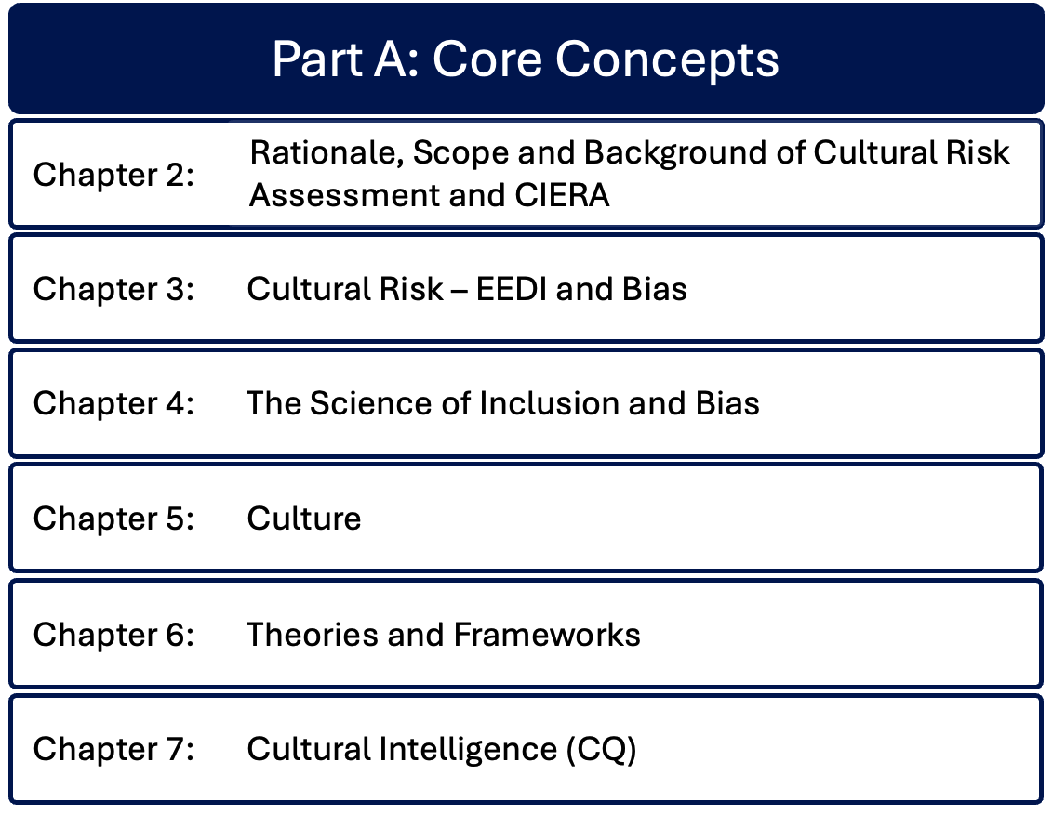

Slide 4
Summary – Chapter 2: Rationale, scope and background of cultural risk assessment and CIERA
Ruth Dowson & Bernadette Albert
The story of developing cultural risk from teaching events through implementation across multiple projects and sectors.
Introduces key concepts of academic origins of cultural risk: culture, developing cultural capital; space navigation; creating psychological safe spaces; diversity, inclusion, equity and equality; unconscious bias; venuefication; eventization of faith.
These definitions and the development from the cultural risk assessment into the Cultural Inclusivity and Equity Risk Assessment (CIERA©) form the foundation for the remaining chapters

Slide 5
Contextualization
Events can provide opportunities to celebrate richness and distinctive diversity of local and national cultures and identities.
This requires careful management of cultural risks.
Today communities and nations are not entities with one single voice. Their vitality comes from the blend of contrasting tones, as participants contribute meaningfully to a complex whole.
Events can offer a platform to these many voices, but can also create environments that facilitate and embed ‘otherness’.
Tensions exist as cultural diversification, political pluralities, social structures, multilingualism and other characteristics lead to ‘otherness’.
The CIERA© and cultural risk assessment approaches provide operational frameworks that identify potential for discord, enabling informed interventions to event design and delivery.

Slide 6
Rationale and Origins of CIERA©
The model supports the identification and management of cultural risks in event contexts; a proactive approach for events, festivals, celebrations and event venues to ensure inclusivity for groups and individuals.
The event manager’s role is to identify, acknowledge and respect issues concerning values, rituals, behaviours, and diverse practices, providing and supporting inclusive environments.
CIERA© suggests specific areas to consider when planning events, proposing actions to manage risks.
The rationale for this approach is made on moral, ethical, and legal grounds.

Slide 7
Key areas for consideration of cultural risks
Demographic and lifecycle contexts
Gender and sexuality orientation
Mental health awareness, including impacts of anxiety and depression on individual and crowd behaviours
Ensuring accessibility to events and venues for those with visible and non-visible disabilities
Awareness of sensitivities around race and ethnicity, with inclusive practice, e.g. use of imagery, portrayal, stereotypes, bias and implicit or unconscious bias
Language barriers and communication styles
Specific religious protocols and considerations of event elements (e.g. timing, hospitality) anticipating religious practices
Dietary requirements and alcohol sensitivities
Understanding different cultures
Intersectionality
Enhancing the development of cultural capital.

Slide 8
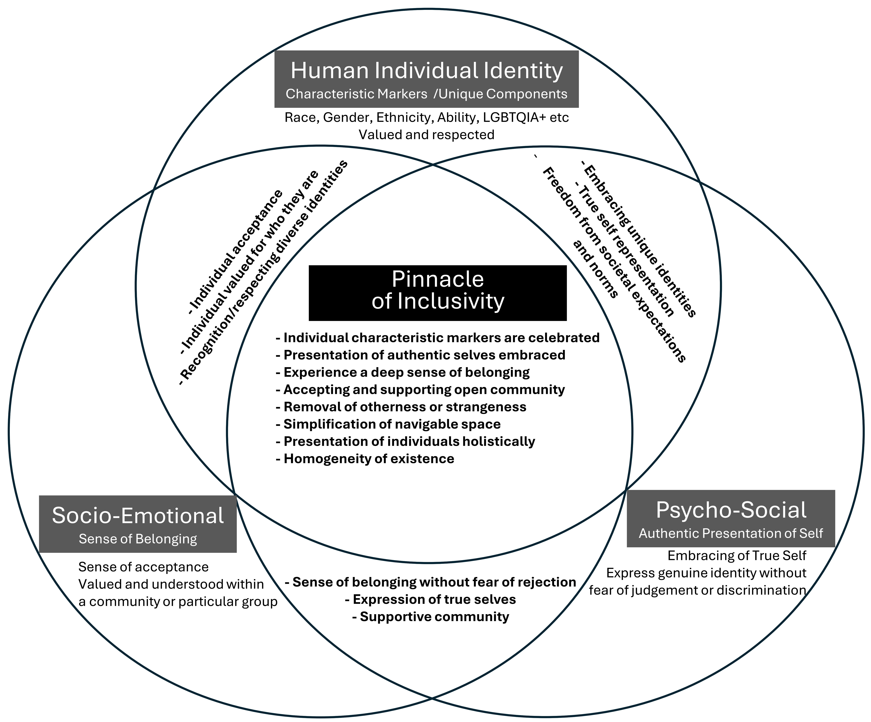
Representation of relationships and interactions between inclusive spaces and individuals

Slide 9
Key concepts and academic origins
Culture and developing cultural capital
Space navigation
Cultural practices have profound impacts on all aspects of life
Culture is fluid, evolves over time
Bordieu – concept of cultural capital (1986)
Awareness of diverse culture enhances cultural capital
Expanding cultural competence can improve intergroup attitudes and create more welcoming spaces
Fundamental to how people manoeuvre through physical, social and psychological dimensions
Impacted by physical and psychosocial construction of space
Event spaces should be designed to support identity, foster community and cultural positioning and dynamics

Slide 10
Key concepts (2)
Creating psychological safe spaces
Diversity, inclusion, equity, equality
Necessary to challenge existing positions; feel supported, understood, accepted, able to express views
Enables deep discussions and desire to participate, offering diverse viewpoints
Challenges stereotypes, prejudices, unconscious bias
Lived experience of others and self
Diversity: different backgrounds, including race, ethnicity, gender, sexual orientation, age, abilities, from different geographic localities and cultures; does not ensure delivery or access to unique characteristics.
Equity: fairness and provision of access to equal opportunities and resources, irrespective of defining characteristics, with the objective of achieving positive outcomes for those groups.
Equality: treating all individuals the same, regardless of unique characteristics, needs or circumstance
Inclusion: creating environments where diverse individuals feel represented, valued, and can present authentically within those environments

Slide 11
Key concepts (3)
Unconscious Bias
Venuefication
Neurology of bias and how unconscious bias influences how individuals navigate everyday life, need to understand how prejudice, stereotypes, and other discriminatory mindsets develop.
To undo unconscious or implicit bias, need to appreciate that whilst some bias is conscious and overt, as humans, our neurology predisposes to bias.
This enables us to make sense of our everyday lives, to facilitate decision-making and to process the volume of data required for daily conscious and unconscious functioning of the human system.
Demand for events throughout life requires more venues - multipurpose
Everywhere can be an event venue
The venue’s prime function is prioritised over other activities, whether event-related or not
Places of worship e.g. church have additional complexity due to overlayering of theological considerations of sacred space
Suitability, Feasibility, Acceptability

Slide 12
Eventization of Faith
Churches engage with congregations and local community through events
Churches as venues for external (non-religious hire) have additional layers of meaning – spiritual, historical, heritage – which vary according to denomination / religious tradition
Influence of Canon Law on what is permissible for traditional denominations (e.g. Roman Catholic, Anglican)
Individual churches need to assess their own strategic positioning and perspectives prior to engaging in events
Cultural Risk Assessment assists churches as venues across all event elements (see next slide)

Slide 13
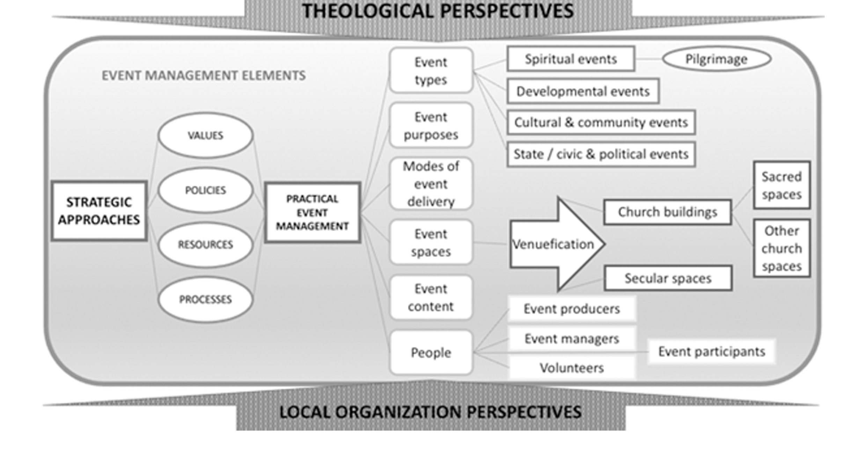

Slide 14
Developing CIERA© from a Cultural Risk Assessment
10 years of theoretical and practical development led to the CIERA©
Utilised our own diverse backgrounds, sharing professional and personal experiences and perspectives with students
See next slide for summary of CRA development process
Teaching and learning enabled development from a risk assessment of cultural issues at events, to applying the Cultural Risk Assessment to real life events
Collaborated with external groupings and applied the CRA tool in academic and professional projects

Slide 15
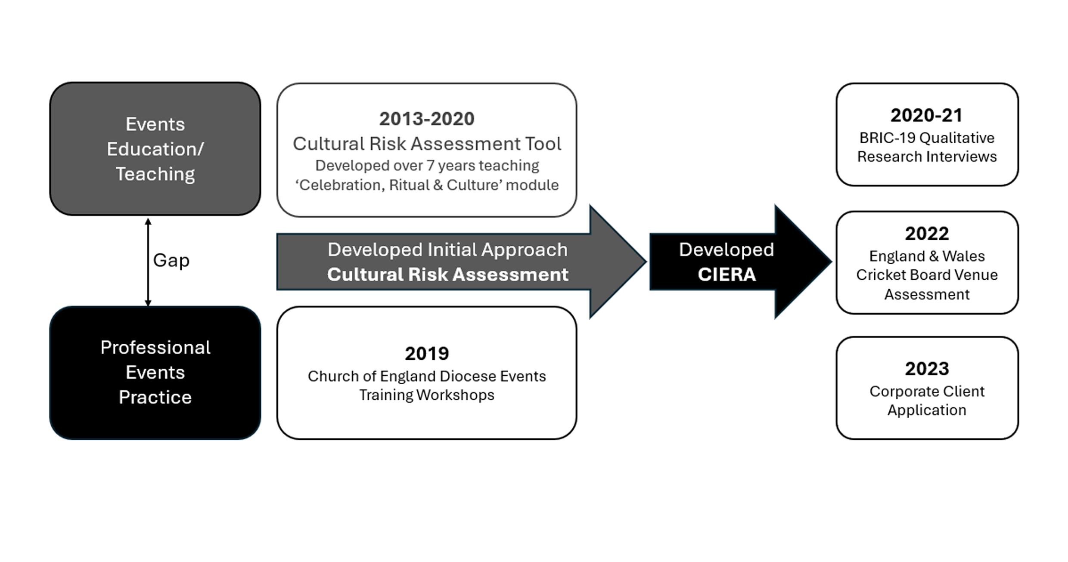

Slide 16
Summary – Chapter 2
Benefits of reflecting on diversity and equality to drive inclusion in event spaces
New ways of collaborative working to bring more successful outcomes
Tested through teaching and practical application; iterative learning and improvement led to the creation of the CIERA©

Slide 17
Discussion Questions
Identify three contexts that would be relevant to undertake a cultural risk assessment
What are three benefits of assessing cultural risks in the three contexts you have identified?
What are three benefits of assessing cultural risks in events generally?
What three cultural aspects would you benefit from learning about?
Research reliable sources for learning about those three cultural aspects.

